Slide 1
Intro to Natural Language Processing (NLP) Session 1
Mohammad A Al-Mamun, PhD Department of Pharmacy Practice
November 15, 2019

Slide 2



NLP
Personal Assistants like Siri, Cortana or Google Assistant

Slide 3

NLP
Auto-completion in search engines like Google or Bing

Slide 4


NLP
Spell checkers in Microsoft Word or Grammarly

Slide 5


NLP
Chatbots and Automated phone answering

Slide 6
What is NLP?
Natural Language Processing is an interdisciplinary field concerned with the interactions between computers and human natural languages (like English) — speech or text.
It is a way for computers to analyze, understand, and derive meaning from human language in a smart and useful way.
Notes:
Chatbot example
NLP-powered software helps us in our daily lives in various ways.
sentiment analysis models to predict whether customer reviews are positive, negative, or neutral and so on.

Slide 7
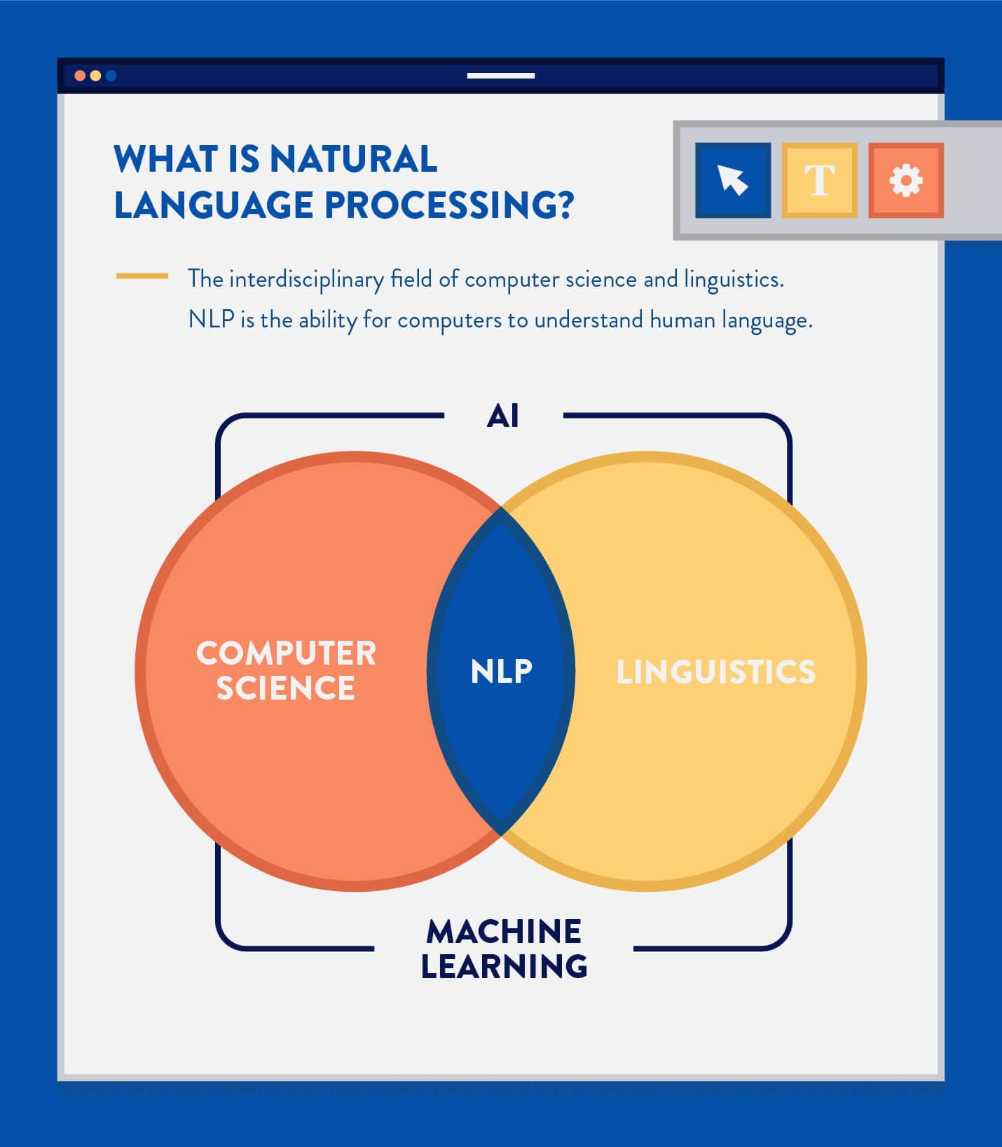
NLP is the sub-field of AI that is focused on enabling computers to understand and process human languages.

Slide 8
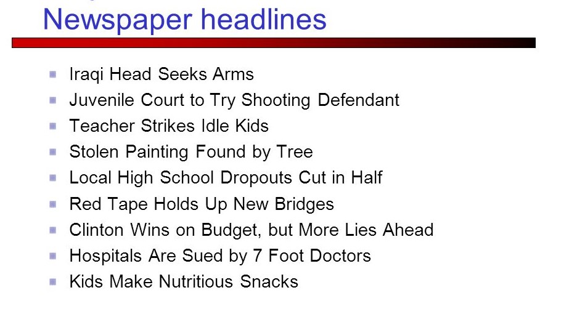
Consider:
Computers are not brains
Language understanding is built-in to the human brain
Computers do not socialize
Language is about communication with people

Slide 9
Why is NLP difficult?
The ambiguity and imprecise characteristics of the natural languages are what make NLP difficult for machines to implement.
NLP requires understanding the words as well as how the concepts are connected to deliver the intended message.

Slide 10
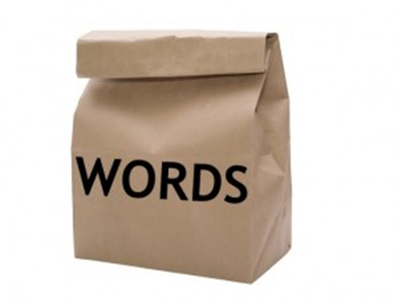
NLP Terminology
Bag of Words – A commonly used model in methods of Text Classification.
A piece of text (sentence or a document) is represented as a bag or multiset of words.
For example: "Well, well, well," said John.
"There, there," said James. "There, there.“
The resulting bag of words representation:
{
'well': 3,
'said': 2,
'john': 1,
'there': 4,
'james': 1
}

Slide 11
NLP Terminology
Corpus or Corpora – A usually large collection of documents that can be used to infer and validate linguistic rules, as well as to do statistical analysis and hypothesis testing.
Stemming – The process of eliminating affixes (suffixes, prefixes, infixes, circumfixes) from a word in order to obtain a word stem.
reading → read

Slide 12
NLP Terminology
Statistical Language Modeling – The process of building a statistical language model which is meant to provide an estimate of a natural language.
Scraping – It is a technique employed to extract large amounts of data intended for display to an end-user.

Slide 13
NLP Terminology
Normalization – Normalization refers to putting all text on a level playing field: converting all text to the same case (upper or lower), removing punctuation, expanding contractions, converting numbers to their word equivalents, and so on. Normalization allows processing to proceed uniformly.
Parts-of-speech (POS) Tagging – POS tagging consists of assigning a category tag to the tokenized parts of a sentence. The most popular POS tagging would be identifying words as nouns, verbs, adjectives, etc.

Slide 14

NLP Terminology
Sentiment Analysis – The use of Natural Language Processing techniques to extract subjective information from a piece of text such as positive or negative.

Slide 15
NLP Libraries in Python
NLTK (Natural Language Toolkit) – leading platform for building Python programs to work with human language data
Spacy – advanced Natural Language Processing in Python and Cython with pre-trained statistical models and word vectors
Scikit-learn – provides some very useful models and algorithms for natural language processing
Gensim – library used for topic modelling, document indexing and similarity retrieval with large corpora
Pattern – provides tools for data mining, NLP, network analysis by graph centrality and visualization
Polyglot – natural language pipeline and supports massive multilingual applications

Slide 16
R Packages for NLP
OpenNLP: An R package which provides a machine-learning-based toolkit for natural language processing activities. Apache OpenNLP is widely used for most common tasks in NLP, such as tokenization, POS tagging, named entity recognition (NER), chunking, parsing, and so on.
Rweka: Data-mining activities, such as data processing, supervised and unsupervised learning, association mining, and so on, can be performed using the RWeka package.
tm
languageR
koRpus
RKEA
Notes:
OpenNLP: An R package which provides a machine-learning-based toolkit for natural language processing activities. Apache OpenNLP is widely used for most common tasks in NLP, such as tokenization, POS tagging, named entity recognition (NER), chunking, parsing, and so on.
Rweka: Data-mining activities, such as data processing, supervised and unsupervised learning, association mining, and so on, can be performed using the RWeka package.
Tm : A framework for text mining applications within R.
LanguageR: Used for analyzing linguistic data
koRpus: An R Package for Text Analysis Basic import functions for language corpora are also provided, to enable frequency analyses (supports Celex and Leipzig Corpora Collection file formats) and measures like tf-idf.
RKEA: The RKEA package provides a R interface to KEA1 , a tool for keyword extraction in texts.

Slide 17
Building an NLP Pipeline
The idea is to break down the process of understanding English into small chunks and solve each individual smaller piece separately.
Chain all pieces together and accomplish the NLP tasks.
Example for processing:
London is the capital and most populous city of England and the United Kingdom. Standing on the River Thames in the south east of the island of Great Britain, London has been a major settlement for two millennia. It was founded by the Romans, who named it Londinium.

Slide 18
NLP Pipeline
Step 1: Sentence Segmentation
Breaking the text apart into separate sentences.
“London is the capital and most populous city of England and the United Kingdom.”
“Standing on the River Thames in the south east of the island of Great Britain, London has been a major settlement for two millennia.”
“It was founded by the Romans, who named it Londinium.”

Slide 19
NLP Pipeline
Step 2: Word Tokenization
The first sentence:
“London is the capital and most populous city of England and the
United Kingdom.”
Break this sentence into separate words or tokens. This is called tokenization. The result:
“London”, “is”, “ the”, “capital”, “and”, “most”, “populous”, “city”,
“of”, “England”, “and”, “the”, “United”, “Kingdom”, “.”

Slide 20
NLP Pipeline
Step 3: Predicting Parts of Speech
Look at each token and identify its part of speech — a noun, a verb, an adjective and so on.
With this information we can see that the nouns in the sentence include “London” and “capital”, so the sentence is probably talking about London.

Slide 21
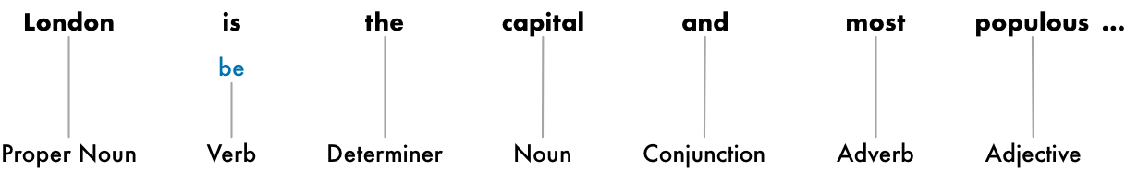
NLP Pipeline
Step 4: Text Lemmatization
Lemmatization is related to stemming,
Difference is that lemmatization captures canonical forms based on a word's lemma.
Lemmatization Result: better → good
For our example:

Slide 22
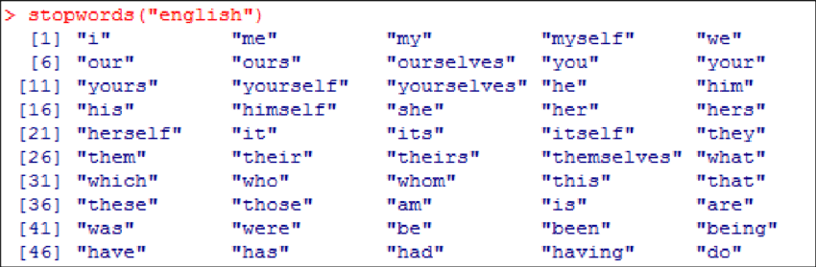
NLP Pipeline
Step 5: Identifying Stop Words
Stop words are words which are filtered out before processing of natural language data.
Generally the most common words in a language.

Slide 23
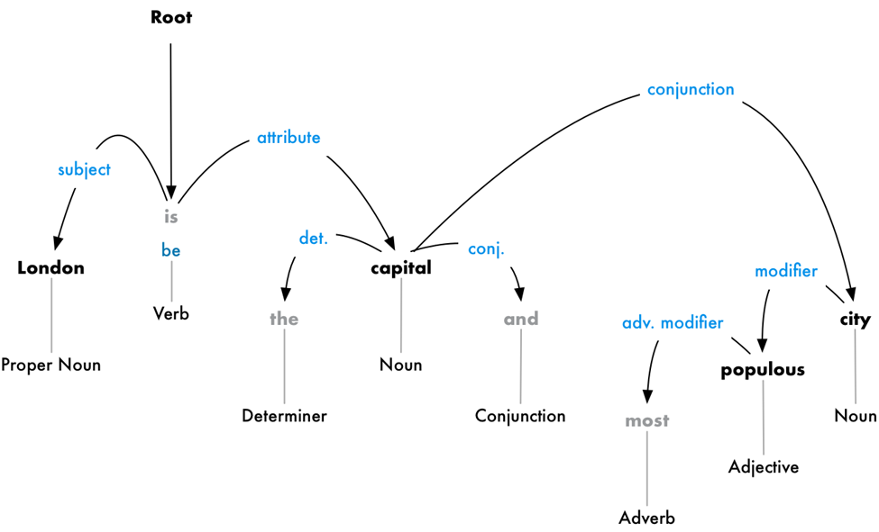
NLP Pipeline
Step 6: Dependency Parsing
Figuring out the relationship between all the words in the sentence

Slide 24
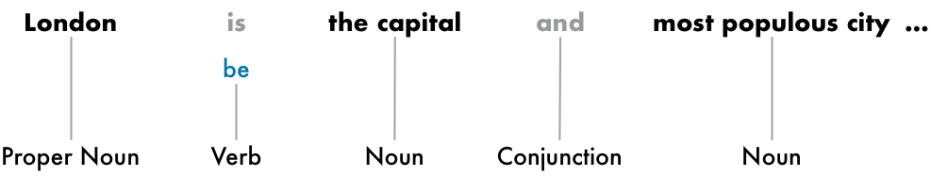
NLP Pipeline
Step 7: Finding Noun Phrases
Use the information from the dependency parse tree to automatically group together words that are all talking about the same thing.

Slide 25

NLP Pipeline
Step 8: Named Entity Recognition (NER)
Some of the kinds of objects that a typical NER system can tag:
People’s names
Company names
Geographic locations
Product names
Dates and times

Slide 26
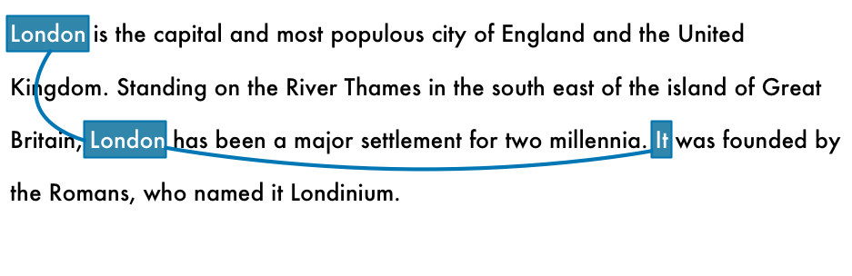
NLP Pipeline
Step 9: Coreference Resolution
The goal of coreference resolution is to track pronouns across sentences. All the words that are referring to the same entity will be identified.

Slide 27
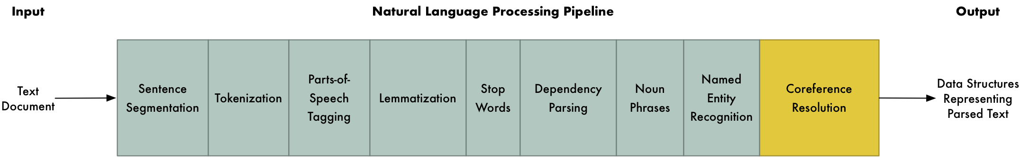
NLP - Entire Pipeline

Slide 28
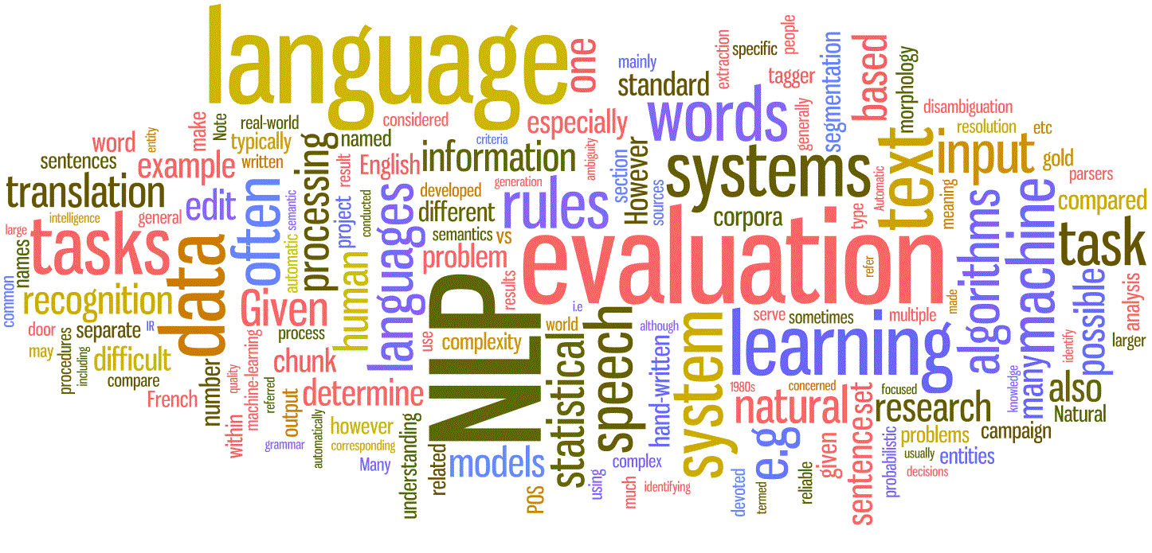
Next Week
Intro to
Text Mining

